Slide 1

Enhanced Care Observations
A Guide for NHSP Staff working at Bolton NHS Trust
Joy Redwood- Enhanced Care / Falls Lead
2025

Slide 2
What does the term “Enhanced Care” mean at Bolton ?
Previously known as ‘specialing’, originally came from the Mental Health Hospitals and adapted within the Acute Hospital Trusts
Enhanced Care is when a patient or cohort of patient require an increased level of Nurse to Patient care due to their complexity or acuity
Enhanced care is defined as “ watching attentively “ while minimising the extent to which they feel that they are under surveillance , encouraging communication, listening and conveying to the patient that they are valued and cared for, are important components of skilled nursing observation
Enhanced care includes anyone who requires additional care and support to ensure their safely whilst in our care e.g. cognitive impairment, alcohol withdrawal, dementia, clinical agitation .
An Enhanced Care policy was introduced 2013 to help identify these patients; which includes a risk assessment , ABC Charts and guidance and support

Slide 3

The Importance of Person Centred Care
Person Centred Care Approaches:
“Person centred care involves tailoring a person`s care to their interests, abilities , history and personality . This helps to ensure people with Dementia or a cognitive impairment can take part in the things they enjoy. It can be effective way of preventing behavioural and psychological symptoms of Dementia” ( BPSD)

Slide 4
How do we Identify Patients who need Enhanced Care Observations ?
Nursing documentation is completed by the nursing teams which include an Enhanced Care Risk Assessment (see slide 5)
Nursing staff complete a risk assessment on EPR called the POST ( Patient Observation Scoring tool ) (see slide 6)
Once completed the POST tool will recommend the level of observation required (see slide 6)
There are 4 levels (see slide 7)
Blue - General Observations
Green – Intentional Rounding 15-30 minute checks
Amber – Continuous Observations: Bay Tagging
Red – Continuous Observations : Arms reach

Slide 5

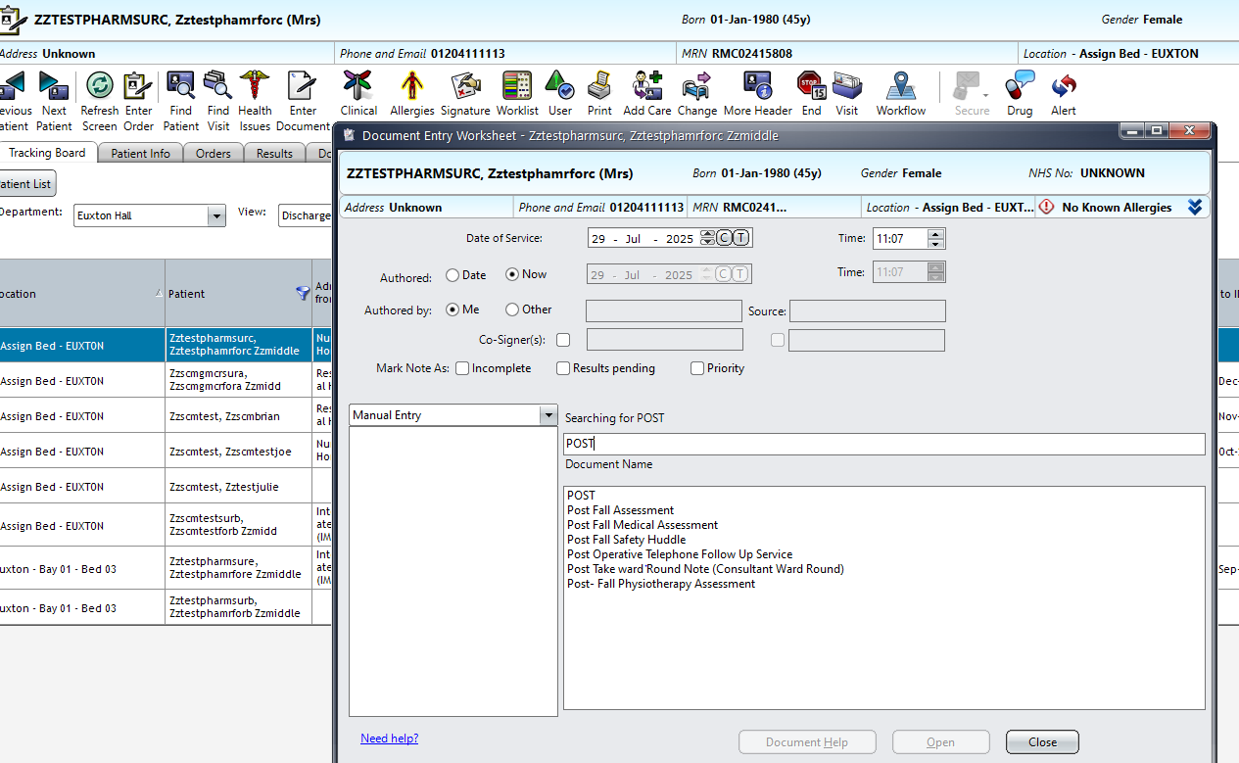
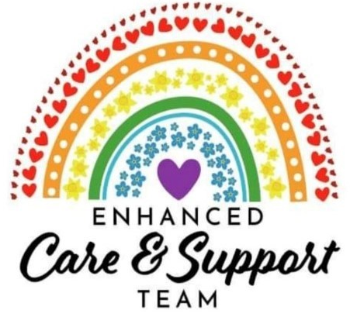
Where to find the POST (Patient Observation Scoring Tool )
Step 1: Click “Enter Documents”
POST is a risk assessment used to identify what level of Enhanced Care observation a patient is requiring
A POST must always be completed via “Enter Document” on EPR.
Step 2: Type “POST “into the search bar.
Step 3: Double click on the option; “POST”
RED patients cannot be discharged to IMC/ DTA beds – therefore have to stay in hospital longer please be accurate with your scoring !!

Slide 6
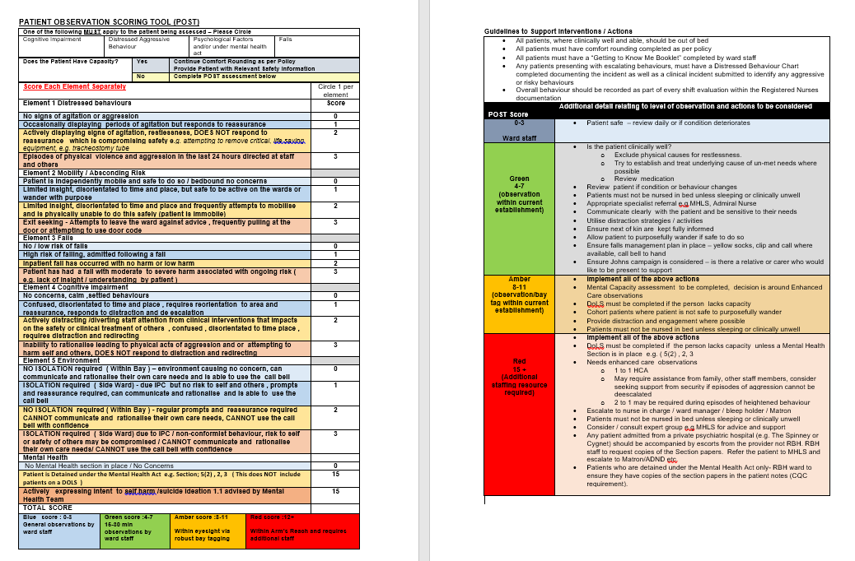
Example of the POST Screening
Select ONLY 1 x appropriate section in each Element
Be Mindful
This is a risk assessment about the PATIENT NOT about Staffing Levels
“DOLs” does not class as a MHA Section on the POST.

Slide 7
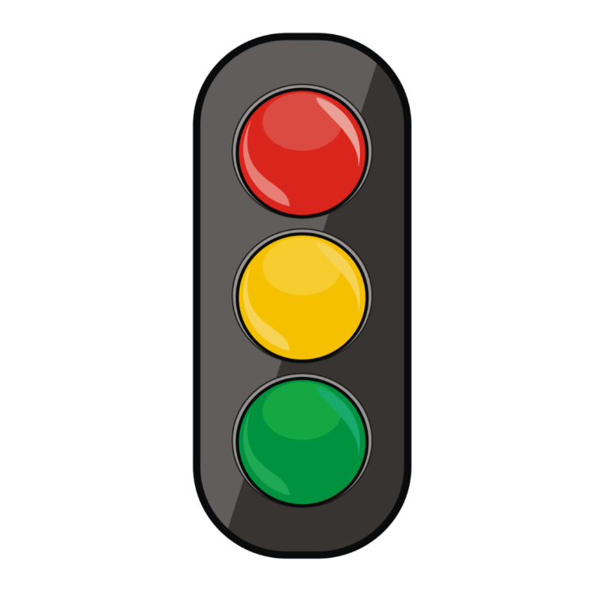
New levels of Enhanced Care Observations POST ( Patient Observation Scoring Tool )
Blue –score 0-3 General observations is the minimal acceptable level of observations for all patients . The location of all patients should be known to staff, but do not require to be kept within eye sight
Green – score 4-7 Intermittent Observations means that the patients location must be checked at frequent intervals , exact times must be specified on the care plans 15-30 min observations by ward staff ( intentional rounding )
Amber – score 8-11 Within eyesight is required when the patients is at risk of harm to themselves or others, robust bay tagging with accurate ABC charts are required
RED- score 12-15 Within Arms Reach observations is required for patients who are at the highest risk of harming themselves or others. Consistent detailed ABC charts are required

Slide 8
Importance of ABC Charts
ABC charts help provide rationale for observation and essential when managing patients who may be at risk to self and others , they support treatment plans, discharge planning and help with risk assessment and rescoring of the POST risk assessment
ABC charts stands for Antecedence, Behaviour and Consequence and it is an important way of reviewing how well a person with behavioural problems is responding to difficult situations. Completed ABC charts and /or diaries should be reviewed along with the persons care plans at regular intervals, including at medication review, to help decide what plan of action to continue with and whether change in medication is effective.
Antecedence
Record the situation in which the problem occurred, for example Time of day, activities that were happening or about to happen Was anything different to their usual behaviour Any other clues to set the scene e.g. lots of noise, buzzers ringing
Behaviour :
Record the actual behaviour What happened? How long did it last for? how severe was it? Did anyone present do anything to try and manage it? If so what ?
Consequence:
How did the behaviour settle? How did the person respond in attempts to manage the behaviour Important to include things that did not work, and include what worked well Were there any significant consequences e.g family members refusing to visit, care staff injured, patient fell or hurt themselves Did anything else happen after the episode of behaviour?

Slide 9
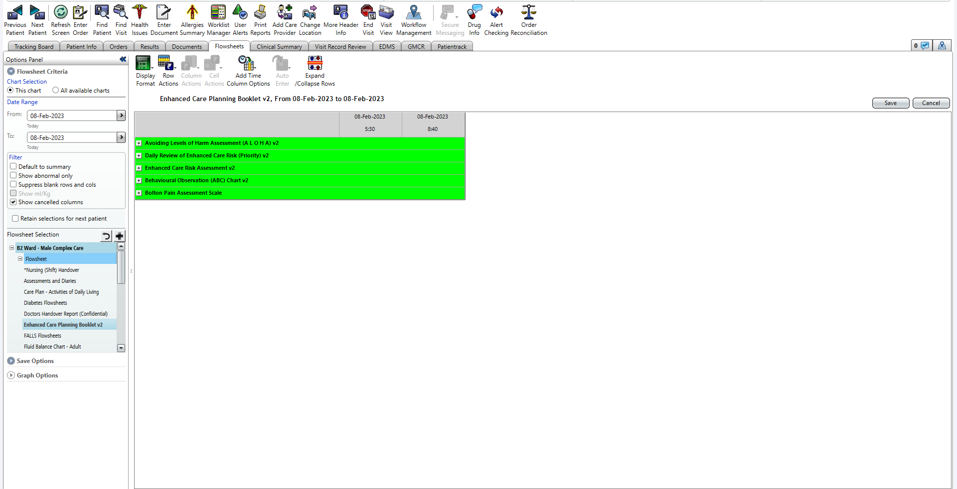
Where to find the ABC Charts on EPR
Step 1:
Select patient, and enter flowsheets.
Step 3:
Add single time column and select “Behavioural Observation (ABC) Chart v2”.
Step 2:
Select “Enhanced Care Planning Booklet v2”.

Slide 10
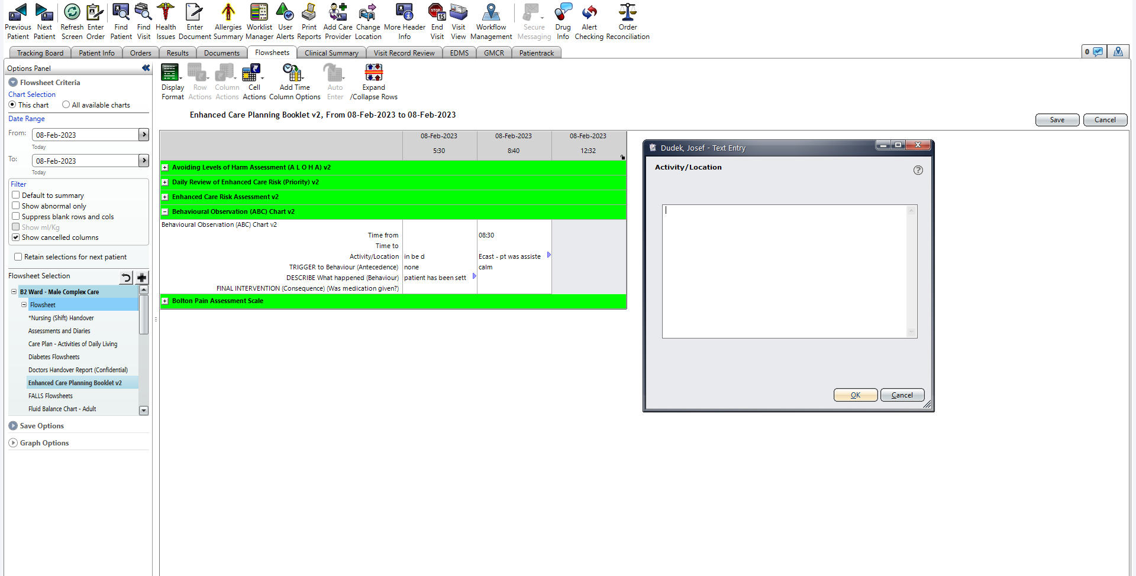
Where to find ABC Charts
Step 4: Begin to fill each section out.
Starting with the time frame you was with patient.
Step 5: Use the text box to describe the Positive & negative behaviours that have occurred.

Slide 11
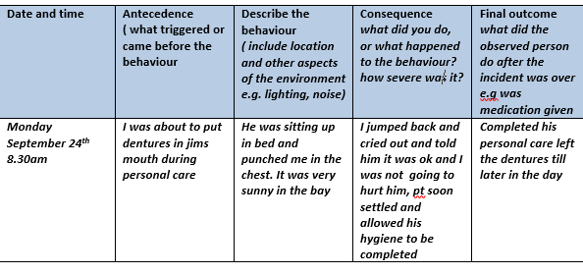
ABC Charts; Example

Slide 12
ABC Charts: additional information
Within comfort diaries, you now have the option for “positive behaviours observed”. It is important we log positive behaviours
BOTH positive and negative behaviours must be documented.
Mental Health rely on ABC Charts to complete their reviews.
All Level Amber & Red patients must have a minimum of 4 hourly ABC Charts.
ABC Charts contribute to medication changes for mental health drugs.
ABC Charts can support with diagnostics – theme, trends, times of behaviours are important. Please provide accurate details and any identified triggers
All ABC Charts are sent to care homes to support with discharges – be mindful.
IF IT’S NOT DOCUMENTED THE BEHAVIOUR DIDN’T HAPPEN

Slide 13
Factors to consider: P.I.N.C.H. M.E
P- Pain…..(is the patient in pain)
I – Infection…..(is there any signs of infection)
N – Nutrition…..(has the patient eaten)
C – Constipation…..(when did the patient open their bowels)
H – Hydration…..(when did the patient last drink)
M – Medication…..(has the patient had their medication)
E- Environment…..(what is the environment like? Noisy/ Busy/ Small Space

Slide 14
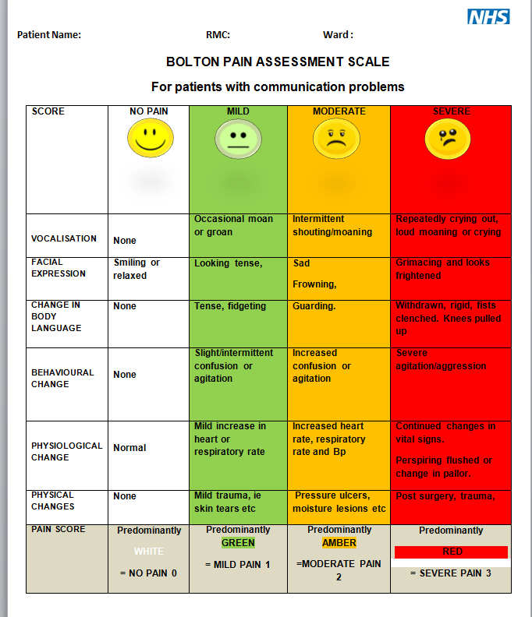
Bolton Pain Assessment Scale; Can be found in Assessments and Diaries on EPR, to help identify Pain with patients who have communications difficulties

Slide 15
Delirium / Dementia
What is Delirium
Delirium (or acute confusion) is characterised by disturbed consciousness and cognitive. It is often has a rapid onset and a fluctuating course.
It may be caused by any acute physical illness e.g. urine/chest infections, or drugs (opiates) and is a serious medical condition.
Delirium can be HYPOactive or HYPERactive but some people show signs of both (mixed).
Common types of Dementia
Alzheimer's ( AD)
Vascular Dementia ( VAS)
Mixed ( AD & VAS
Lewy Body Dementia
Parkinson dementia
Frontal Temporal Dementia ( Sometimes known as PICKS disease)

Slide 16
Consider Capacity & DOLS
Consider the following
Do you doubt the patients capacity ?
Complete a capacity for care and treatment to include enhanced care observations ( decision specific )
If the patients has capacity gain consent for bay tagging observations
If the Patient lacks Capacity and not free to leave, request an application for DOLS ( Deprivation of liberty safeguard)
If the Patient lacks capacity and refusing medication consider covert medication plan and non concordance care plan, capacity assessment will be needed around covert medication ( decision specific )
Follow Delirium Screening if this is acute confusion
Refer to Helen Jones DOLS lead if concerns arise

Slide 17
Things to consider : Medication Compliance and Capacity Assessment
Medication compliance is a BIG issue for Enhanced Care patients, a high percentage don’t want to take their medicines and this can affect their behaviour dramatically.
Non concordance with medication will impact a person’s behaviour, always ensure a non-concordance care plan is completed.
If a patient is consistently refusing and missing critical meds, they require a MENTAL CAPACITY ASSESSMENT FOR ADMINISTRATION OF COVERT MEDICATION – This is done via “Enter Document” by the nurse in charge or a medic.
Once the Mental Capacity Assessment is done - request the appropriate DOL’s paperwork.
Refer to Mental Health if you feel behaviours remain heightened despite mental health medications and PRN’s, OR if you require specific support with a patient and feel their input could be beneficial!

Slide 18
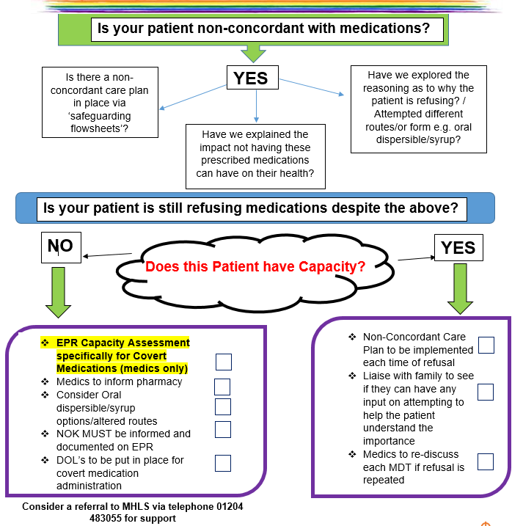
Covert Medication Policy
Patients should NOT be aware they are having medication if they have a covert medication plan in place
ALWAYS covert the medication away from the patient in drink/food.
All patients requiring covert medication NEED a Capacity Assessment FOR Covert Administration of Medication. Completed by a medic/ nurse in charge.

Slide 19
Identifying Triggers: Newcastle Model
How to identify Triggers: Newcastle model
A framework for understanding challenging behaviour ( James& Stephenson, 2007)
Understand behaviour in terms of needs which are unmet, and suggests a structure in which to develop effective interventions that keep people with cognitive impairment (dementia) central to their care. ( Least restrictive)
The behaviour might be the persons way of expressing a need, an attempt to communicate it or a outcome of the unmet need, there could be many reasons:
An inability to communicate fears and or distress
A direct result of the changes in the brain caused by the cognitive impairment
Frustration at no longer being able to carry out tasks
Depression
Feeling unwell
Being unable to express pain
By using the model a patient’s life history can support identification of the triggers and help formulate the patients care plan

Slide 20
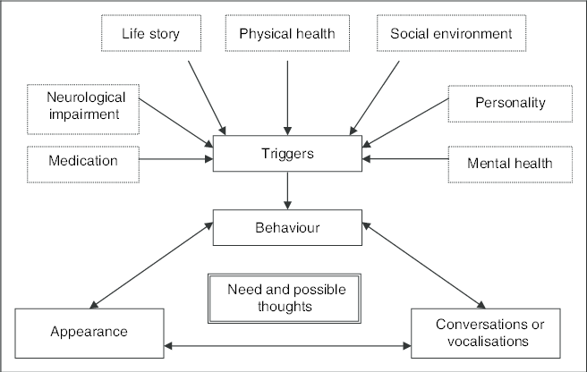
Identifying Triggers using life story

Slide 21
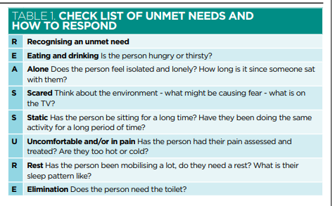
Triggers: Unmet Needs

Slide 22
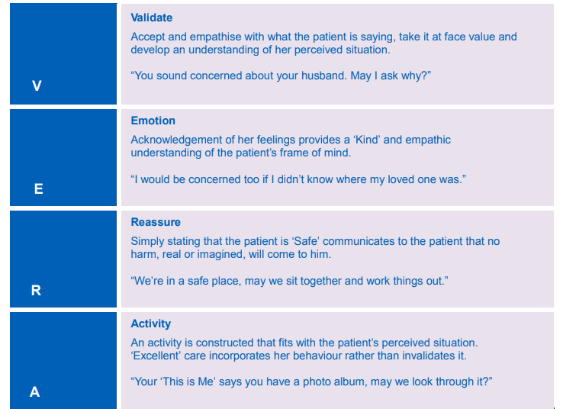
Helping with Communication Follow the : Vera Framework
The VERA framework describes a stage by stage process of communication that guides health care professionals towards providing compassion and caring responses to patients with dementia

Slide 23
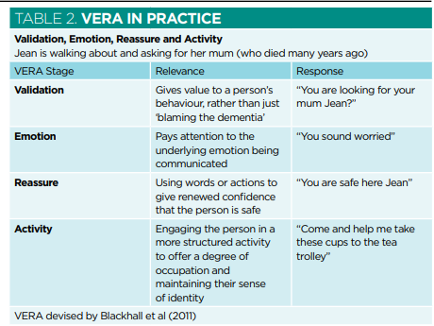
Example of using VERA in practice

Slide 24
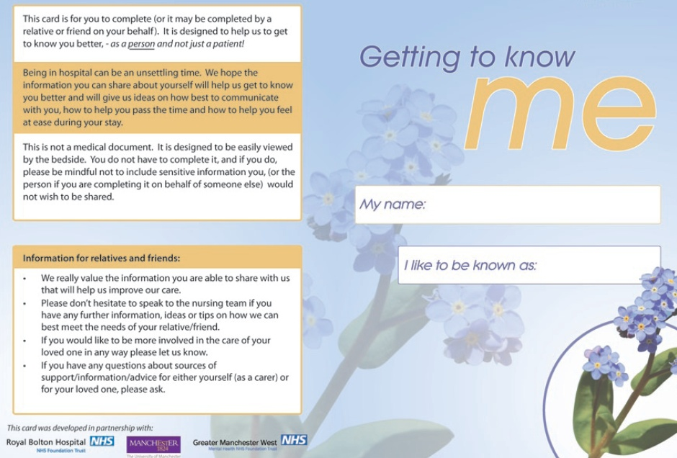
Getting to Know Me booklet ? To care for our Patients with a cognitive impairment, we need to get to know them Please complete this booklet

Slide 25
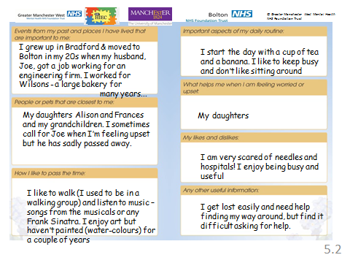
Getting to Know Me - Example

Slide 26
The Importance of Activity and Selecting the Most Appropriate
Benefits
Activities for people with dementia may be more important to their psychological well-being than the physical and social environment
Activity has the potential to: enhance quality of life promote strengths, reduce rate of cognitive decline, enhance relationships and communication, draw on interests and enhance self esteem.
Within a hospital setting it can help prevent de- conditioning by improving function, reduced falls, lifts mood and aids recovery
Selecting an Activity
The general rule for the selection of appropriate activity is that most people gain benefit from an activity which matches their interests and level of cognitive ability
Engagement in activity is likely to change for each person throughout the course of the dementia
Sometimes it may be necessary to adapt an activity depending on the disability that a person with dementia may have
Complete a getting to know me booklet with the patient or family

Slide 27
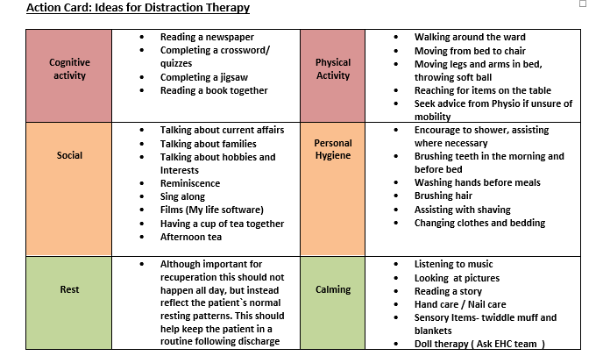
Ward Activities

Slide 28

RITA/ My Life Machines; Contact ECAST team ext. 141820
REMINISCENCE INTERACTIVE THERAPY ACTIVITIES
RITA is a dedicated computerised distraction therapy and has been clinically proven to reduce falls as well as violence and aggression, indeed in some Trusts it has reduced the need for Enhanced Care significantly.
It contains a vast array of music, games and reminiscence materials designed specifically for enhancing the caring relationship.
Features include full length films, bingo, stock footage of old TV programmes, sports matches and a variety of games and apps as well as a featured to record relatives messages for patients.
The Enhanced Care Team are currently using these throughout the trust and they are available on several wards. The Trust has 5 machines in total.

Slide 29
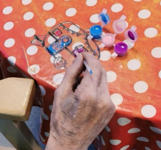
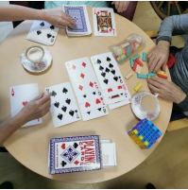
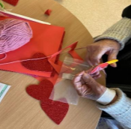
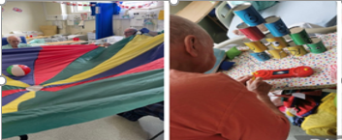

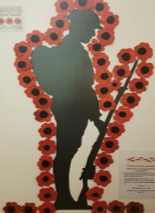
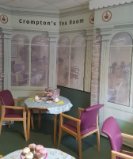
Thankyou Please contact The Enhance care team Ext 14120 for any advice and support

